Slide 1
Lab
Cycle-1
System Calls

Slide 2
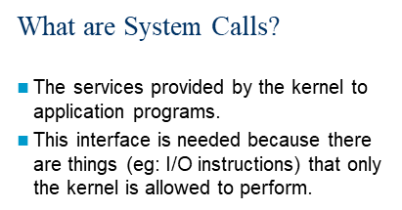

Slide 3
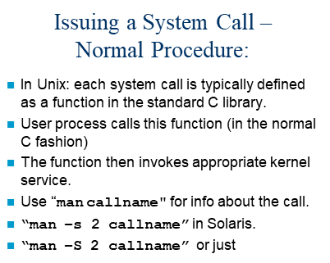

Slide 4

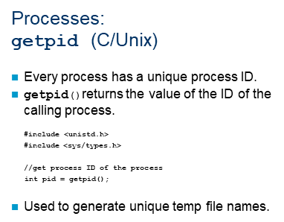

Slide 5
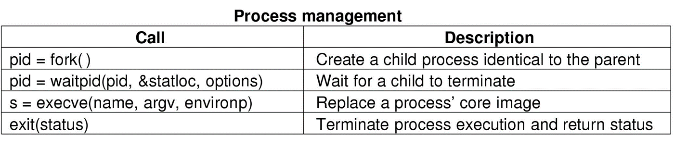

Slide 6
#include <stdio.h>
#include <sys/types.h>
#include <unistd.h>
int main()
{
// make two process which run same
// program after this instruction
fork();
printf("Hello world!\n");
return 0;
}
Hello world!
Hello world!

Slide 7
#include <stdio.h>
#include <sys/types.h>
int main()
{
fork();
fork();
fork();
printf("hello\n");
return 0;
}
hello
hello
hello
hello
hello
hello
hello
hello

Slide 8
fork (); // Line 1
fork (); // Line 2
fork (); // Line 3
L1 // There will be 1 child process
/ \ // created by line 1.
L2 L2 // There will be 2 child processes
/ \ / \ // created by line 2
L3 L3 L3 L3 // There will be 4 child processes
// created by line 3
The number of times ‘hello’ is printed is equal to number of process created. Total Number of Processes = 2^{n}, where n is number of fork system calls. So here n = 3, 2³ = 8

Slide 9
Program for fork()
#include<stdio.h>
#include<unistd.h>
#include<sys/types.h>
int main()
{
pid_t p;
printf("before fork\n");
p=fork();
if(p==0)
{
printf(“Child Process ID %d\n",getpid());
printf(“ parent's id is %d\n",getppid());
}
else{
printf("child's id is %d\n",p);
printf("I am parent having id %d\n",getpid());
}
printf("Common\n");
}

Slide 10
exec()
The exec family has many functions in C. These C functions are basically used to run a system command in a separate process that the main program and print the output.
The exec family of functions replaces the current running process with a new process. It can be used to run a C program by using another C program.
The available exec functions along with their function parameters are given below:
int execl(const char *path, const char *arg, …, NULL);
int execlp(const char *file, const char *arg, …, NULL );
int execv(const char *path, char *const argv[]);
int execvp(const char *file, char *const argv[]);
int execle(const char *path, const char *arg, …, NULL, char * const envp[] );
int execve(const char *file, char *const argv[], char *const envp[]);

Slide 11
execvp : Using this command, the created child process does not have to run the same program as the parent process does. The exec type system calls allow a process to run any program files, which include a binary executable or a shell script
//EXEC.c
#include<stdio.h>
#include<unistd.h>
int main()
{
int i;
printf("I am EXEC.c called by execvp() ");
printf("\n");
return 0;
}
Now,create an executable file of EXEC.c using command
gcc EXEC.c -o EXEC

Slide 12
//execDemo.c
#include<stdio.h>
#include<stdlib.h>
#include<unistd.h>
int main()
{
/*A null terminated array of character pointers*/
char *args[]={"./EXEC",NULL};
execvp(args[0],args);
/*All statements are ignored after execvp() call as this whole process(execDemo.c) is replaced by another process (EXEC.c) */
printf("Ending-----");
return 0;
}
Now, create an executable file of execDemo.c using command
gcc execDemo.c -o execDemo
After running the executable file of execDemo.cby using command ./excDemo, we get the following output:
I AM EXEC.c called by execvp()

Slide 13
Wait()
call to wait() blocks the calling process until one of its child processes exits or a signal is received. After child process terminates, parent continues its execution after wait system call instruction. Child process may terminate due to any of these:
It calls exit();
It returns (an int) from main
It receives a signal (from the OS or another process) whose default action is to terminate.

Slide 14
/* C program to demonstrate working of wait()*/
#include<stdio.h>
#include<sys/wait.h>
#include<unistd.h>
int main()
{
if (fork() == 0)
printf("HC: hello from child\n");
else
{
printf("HP: hello from parent\n");
wait(NULL);
printf("CT: child has terminated\n");
}
printf("Bye\n");
return 0;
}

Slide 15
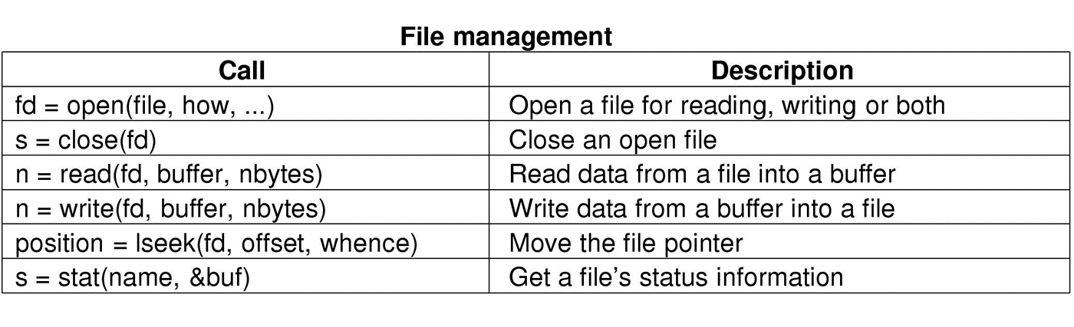
File management System calls

Slide 16
#include<unistd.h>
#include<stdio.h>
#include<fcntl.h>
int main()
{
int fd;
char buffer[80];
char msg[50] = “hello!everyone”;
fd=0pen(“check.txt”,0_rdwr);
printf(“fd = %d”,fd);
if(fd!=-1)
{
printf(“\n check.txt opened with read write mode\n”);
write(fd,msg,sizeof(msg));
lseek(fd,0,seek_set);
read(fd,buffer,sizeof(msg));
printf(“\n %s was written to my file \n”,buffer);
close(fd);
}
return 0;
}

Slide 17
Unistd: unistd.h is a built-in header file in Linux/Unix system, which contains function prototypes of many system call
Sys/types:The sys/types. h header file defines a collection of typedef symbols and structures.
sys/types. h.
dev_t Device numbers
off_t File sizes, long
pid_t Process IDs and process group ids
size_t unsigned long
ssize_t Signed long
Fcntl: The <fcntl.h> header shall define the following requests and arguments for use by the functions fcntl() and open().

